Slide 1

Unlocking Insights: Exploring Airbnb with Topic Modeling
Amal vinob
Alliance university

Slide 2
Introduction
Topic modeling is a frequently used approach to discover hidden semantic patterns portrayed by a text corpus and automatically identify topics that exist inside it.
Namely, it’s a type of statistical modeling that leverages unsupervised machine learning to analyze and identify clusters or groups of similar words within a body of text.
For example, a topic modeling algorithm may be deployed to determine whether the contents of a document imply it’s an invoice, complaint, or contract.
Consider a scenario where a business employs a single individual to review each piece of unstructured data and segment them based on the underlying topic. It would be an impossible task . It would take a significant amount of time to complete and be extremely tedious, plus there’s much more risk involved since humans are naturally biased and more error-prone than machines.
The solution is topic modeling.

Slide 3

Type of Model
Topic Modeling with LDA: A Statistical Model
Topic modeling, particularly with Latent Dirichlet Allocation (LDA), is a statistical approach used for unsupervised classification of documents. LDA is a generative probabilistic model that represents documents as mixtures of latent topics, where each topic is defined by a distribution over words.
This statistical nature of LDA allows it to uncover hidden themes within a collection of documents, classify documents into these themes, and organize, understand, search, and summarize large electronic archives. By leveraging Bayesian hierarchical probability generation models, LDA efficiently captures the relationships between words and topics, making it a powerful tool for extracting meaningful insights from text data

Slide 4

How topic modeling works
topic models work by deducing words and grouping similar ones into topics to create topic clusters.
For example, the words “dog” and “bone” are more likely to appear in documents concerning dogs, whereas “cat” and “meow” are more likely to be found in documents regarding cats. Consequently, the topic model would scan the documents and produce clusters of similar words.
Topics
Bag of Words
(BoW)
Topic model
Frequency of words
Topic

Slide 5

Dataset : Air bnb
The Airbnb dataset is a collection of data related to listings, hosts, and reviews from the Airbnb platform. It typically includes information such as property details (e.g., location, size, amenities), host profiles, pricing, availability, and guest reviews. This dataset is valuable for various purposes, including market analysis, property pricing prediction, user behavior analysis, and sentiment analysis.
These are the 5-dataset available to me. Form these 5 dataset the most relevant columns for topic modeling are those containing text data, such as 'description' , 'summary' , 'neighborhood overview' , 'notes' , 'transit' , 'access' , 'interaction' , 'house rules' and 'comments’ .
The potential wealth of information encapsulated in multiple columns. However, we opt to channel our focus towards a singular textual source: the 'comments' column of Dataset - 3("reviews_details").

Slide 6
Review dataset
details
Review : The dataset has a shape of (431,830, 6), meaning it contains 431,830 rows and 6 columns
Columns : 'listing_id', 'id', 'date', 'reviewer_id', 'reviewer_name', 'comments.
Sample comment : 'Daniel is really cool. The place was nice and clean. Very quiet neighborhood. He had maps and a lonely planet guide book in the room for you to use. I didn't have any trouble finding the place from Central Station. I would defintely come back! Thanks!’.
How topic modeling work on this sample comment : from this comment above we can understand about the host experience, quiet neighborhood, accessibility and direction. Overall a positive experience.
These are the basic topics that we can take. This is an outline of the topic modeling. This outline effectively sets the stage for conducting topic modeling on the comment data, guiding the analysis towards uncovering these thematic elements.

Slide 7
Data Description
Variable | Type | Description
listing_id | Continuous | An integer representing the unique identifier for each Airbnb listing.
id | Continuous | An integer representing the unique identifier for each review.
date | Date | A string representing the date when the review was made.
reviewer_id | Continuous | An integer representing the unique identifier for each reviewer.
reviewer_name | Categorical | A string representing the name of the reviewer.
comments | String(object) | A string representing the textual content of the review left by the reviewer.

Slide 8
Preprocessing steps
Aggregation based on listing details: Reviews are aggregated based on listing details such as the listing_id. This helps in organizing the data for analysis and gaining insights specific to different aspects of the listings.
Punctuation removal and lowercasing: Punctuation marks are removed from the text to focus on the actual words. Additionally, all text is converted to lowercase to ensure uniformity and consistency in word representation. This step helps in standardizing the text data and simplifying subsequent processing steps.

Slide 9
Preprocessing steps
Stop words removal: Stop words are common words in a language (e.g., "the", "is", "and") that often occur frequently but typically do not carry significant meaning for analysis. Removing stop words helps in reducing noise and focusing on the more meaningful words in the text. Stop words removal can improve the efficiency of algorithms and the interpretability of results by eliminating irrelevant terms.
Lemmatization: Lemmatization is the process of reducing words to their base or root form, which helps in standardizing words with similar meanings. For example, "running", "ran", and "runs" all reduce to the lemma "run". Lemmatization aids in reducing word variations and improving the accuracy of analysis by treating different forms of a word as the same entity.
Overall, these preprocessing steps are essential for preparing text data for analysis. They help in reducing noise, standardizing text representations, and improving the effectiveness of downstream analysis techniques such as topic modeling.

Slide 10
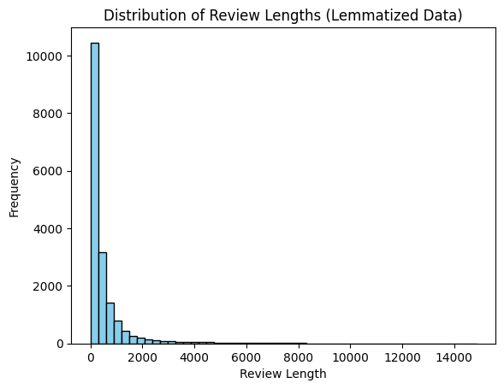
Exploratory Data Analysis
Understanding the Distribution of Review Lengths
In our analysis of review data, we visualize the distribution of review lengths to gain insights into the composition and characteristics of the dataset.
The histogram of review lengths reveals a positively skewed distribution. This skewness indicates that a majority of reviews are relatively short, with fewer reviews being longer in length.
All most all reviews length or the word concentration are below 2000.

Slide 11
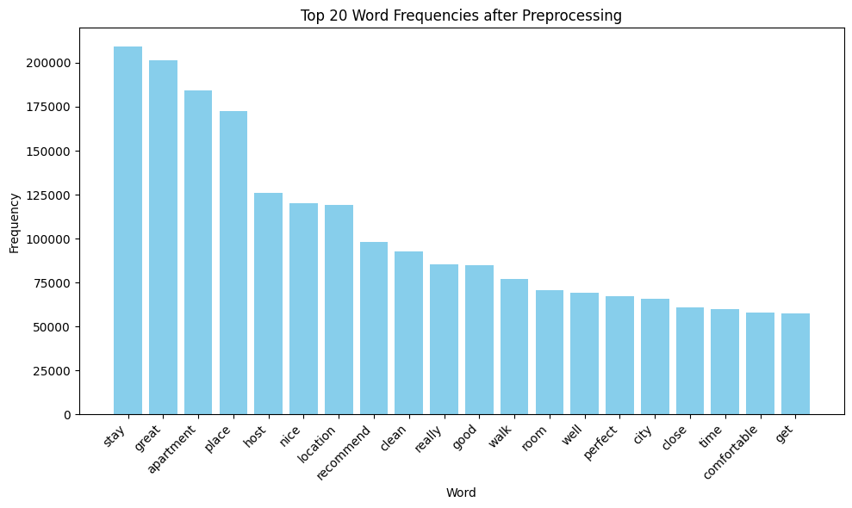
Exploratory Data Analysis
Exploring Word Frequencies after Preprocessing
In our exploration of text data, we visualize the distribution of word frequencies after preprocessing to gain insights into the most common words used in the dataset. By analyzing word frequencies, we aim to identify prevalent terms, patterns, and themes within the corpus.
The bar chart displays the top 20 word frequencies after preprocessing, with each bar representing a unique word and its corresponding frequency in the dataset. The words are sorted in descending order based on their frequency, allowing us to focus on the most common terms used in the corpus.
Analyzing the frequency and context of these words can help property owners and managers understand guest preferences and prioritize areas for improvement to enhance guest satisfaction and drive positive reviews.

Slide 12

Exploratory Data Analysis
Overview of Text Data Statistics
The provided statistics offer insights into the characteristics and composition of the text data, providing a foundational understanding for further analysis and interpretation.
Number of Documents: 17621
The dataset consists of a total of 17,621 documents, representing individual reviews or text entries.
Average Document Length: 533.6427
This metric quantifies the typical length or size of individual documents within the dataset, helping to understand the level of detail or verbosity present in the text data.
Vocabulary Size: 87361
The vocabulary size refers to the total number of unique words or tokens present in the dataset, This metric reflects the richness and diversity of the language used in the corpus, providing insights into the range of terms and expressions employed by users.

Slide 13
Representation of the Distribution of Topics
The representation of the distribution of topics refers to the allocation of topics across the documents within a corpus. This representation often takes the form of a collection of tuples, where each tuple consists of two elements: the topic index and the corresponding count or frequency of that topic in the document.
Topic Index: Each topic in the corpus is assigned a unique index number. This index is used to identify and differentiate between different topics.
Count or Frequency: The count or frequency associated with each topic index indicates how prevalent that topic is within a specific document. It represents the relative importance or significance of the topic within the document.
Example : [(0, 6), (1, 1), (2, 12), (3, 1), (4, 1)]
Here, (0, 6) indicates that Topic 0 appears 6 times in the document, (2, 12) indicates that Topic 2 appears 12 times, and so on.

Slide 14
Representation of the Distribution of Topics
Understanding Topic Distribution: Analyzing the distribution of topics across documents provides insights into the thematic composition of the corpus. It helps identify which topics are prevalent or dominant and how they are distributed across different documents.
Interpretation: A higher count or frequency of a particular topic in a document suggests that the document is more focused on that topic. Conversely, a lower count indicates less relevance or importance of the topic in the document.
Pre-LDA Analysis: Examining the topic distribution before applying topic modeling techniques like Latent Dirichlet Allocation (LDA) can help in understanding the initial composition of topics in the corpus. It may guide preprocessing decisions or parameter tuning for the topic modeling process.

Slide 15
Latent Dirichlet Allocation (LDA)
Latent Dirichlet Allocation (LDA) is a widely used topic modeling technique in natural language processing (NLP) that allows for the discovery of latent topics within a collection of text documents.
Assumptions:
LDA assumes that each document in the corpus is a mixture of various topics, and each topic is a distribution over words.
It also assumes that the words in each document are generated based on this mixture of topics.
2. Model Representation:
In LDA, documents are represented as bags of words, disregarding word order and grammar.
The model represents each document as a probability distribution over a fixed number of topics, and each topic as a probability distribution over the entire vocabulary of words in the corpus.(efers to a collection of text documents that are used for analysis).
Equation :
p(w, z, θ, φ) = p(w|z, φ)p(z|θ)p(θ|α)p(φ|β)
w represents the set of all words in the corpus
z represents the topic assignments for each word
θ represents the topic proportions for each document
φ represents the word distributions for each topic

Slide 16
Latent Dirichlet Allocation (LDA)
3. Topic Discovery:
LDA aims to learn two main sets of parameters: the distribution of topics in each document and the distribution of words in each topic.
It does this by iteratively updating these distributions to maximize the likelihood of observing the given set of documents.
4. Generative Process:
LDA assumes a generative process for creating documents:
For each document, choose a distribution of topics.
For each word in the document:
Choose a topic from the topic distribution.
Choose a word from the corresponding topic's word distribution.

Slide 17
Overview of the topic modeling technique
An unsupervised learning algorithm that assigns a probability distribution over words to each topic and a probability distribution over topics to each document.
Number of Topics Chosen:
In the presented model, 10 topics were chosen to represent the underlying themes within the text data.
Generated Topics and Keywords:
The 10 topics extracted from the data are represented as a list of tuples, where each tuple consists of the topic number and its corresponding keywords. These keywords represent the terms that are most strongly associated with each topic.
For example, Topic 0 is characterized by words such as “house", “host", "stay", "tre", "place", "nice", etc.

Slide 18
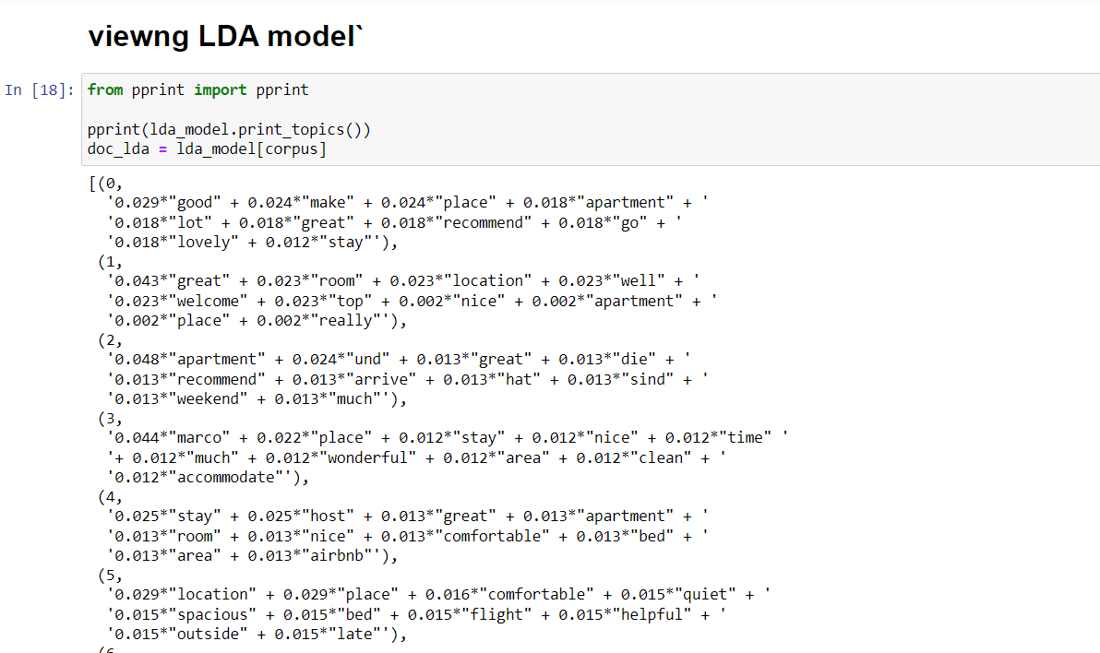
Output of the topic modeling technique
The values multiplied by each keyword in the topic represent the importance or weight of that word within the topic. In the context of Latent Dirichlet Allocation (LDA), these values are typically calculated based on probabilities.
Topic 0:
Keywords: "good", "make", "place", "apartment", "lot", "great", "recommend", "go", "lovely", "stay"
Probabilities: 0.029, 0.024, 0.024, 0.018, 0.018, 0.018, 0.018, 0.018, 0.018, 0.012
These probabilities indicate the likelihood of each word occurring in documents assigned to this topic. The higher the probability, the more significant the word is for that topic. The word "good" has a probability of 0.029, suggesting it is quite significant in this topic.
Similarly, "make", "place", "apartment", "lot", "great", "recommend", "go", and "lovely" all have probabilities of 0.024 or 0.018, indicating their importance in representing this topic.

Slide 19
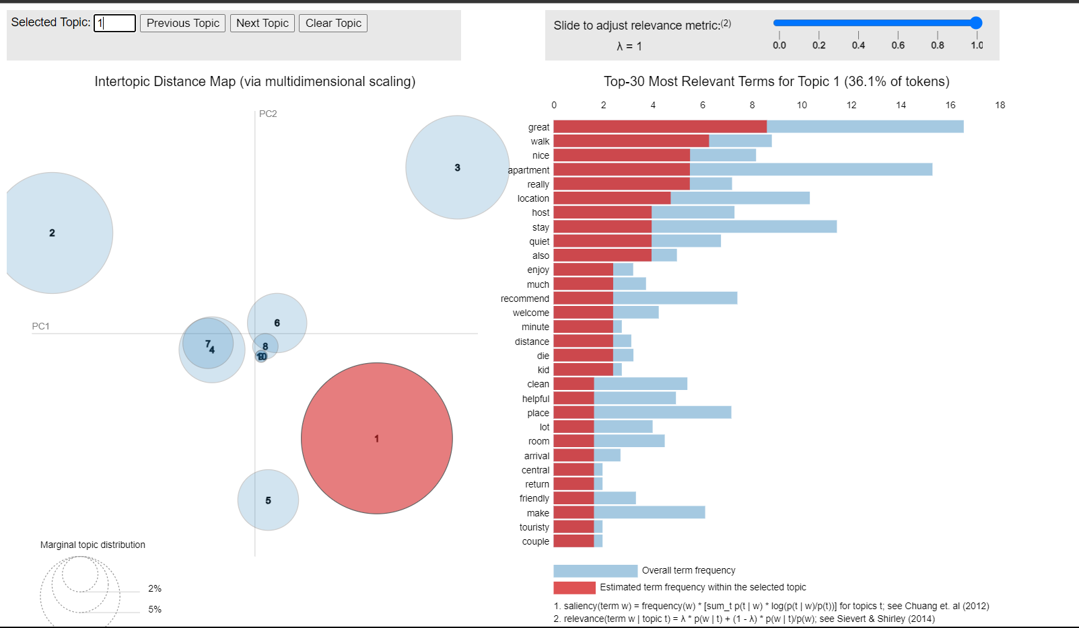
Visualizations of Topic Distributions
Intertopic Distance Map
This is displayed on the left side of the visualization and represents the relationships between topics in a two-dimensional space.
Each bubble represents a topic, and the distance between bubbles indicates the similarity between topics.
Topics that are closer together are more similar in terms of the words they contain.
By hovering over each bubble, you can see the topic number and its relative prevalence in the dataset.

Slide 20
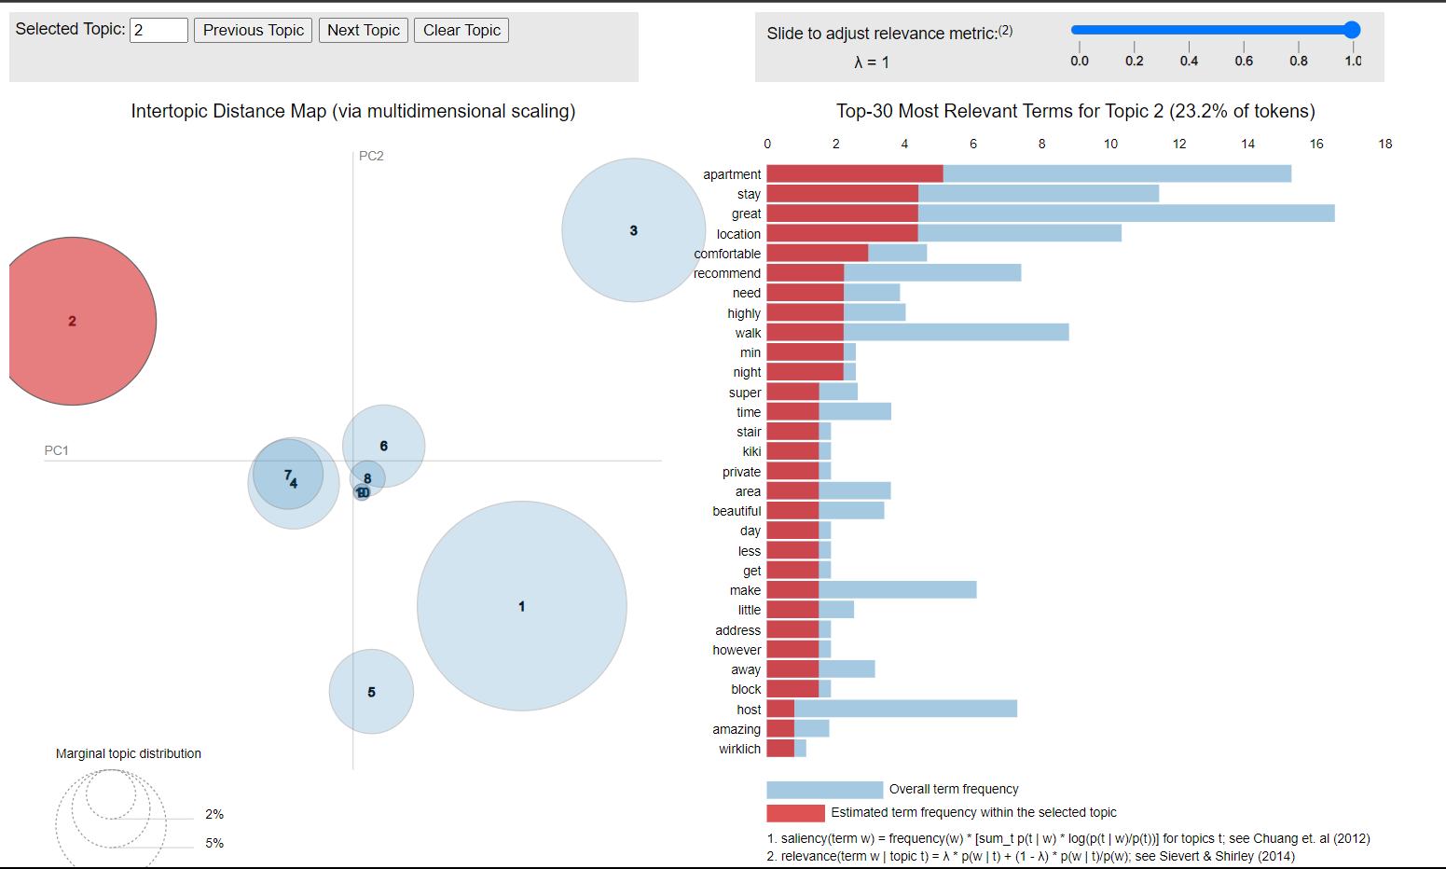
Visualizations of Topic Distributions
hovering over each bubble
The Intertopic Distance Map visually represents the relationships between topics. Topics that appear closer together on the map are more similar in terms of the words they contain. Conversely, topics that are farther apart are less similar. This proximity helps identify clusters of related topics and understand their thematic coherence.
For instance, if Topic 1 , Topic 2, Topic 3 are located far apart on the map, it suggests that they are distinct and have different word distributions

Slide 21
Visualizations of Topic Distributions
Bar chart
This is displayed on the right side of the visualization and provides a detailed view of the most relevant terms for each topic.
For example, when select Topic 1, we can see a bar chart showing the top 30 words associated with that topic.
The height of each bar represents the frequency or importance of the word within the selected topic.

Slide 22
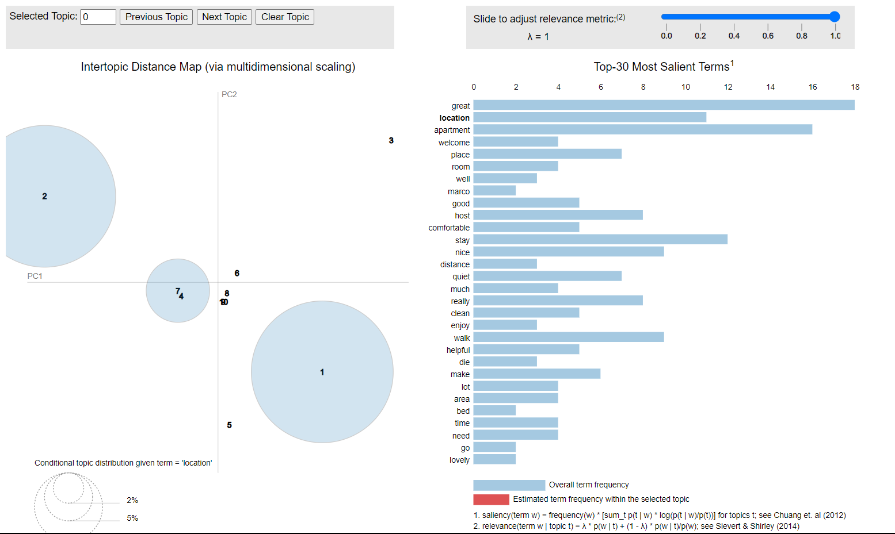
Visualizations of Topic Distributions
Bar chart
While selecting each words the size of the topic also changes
Interacting with the visualization allows us to gain deeper insights into the topics discovered by the model and understand the relationships between them.
It provides an intuitive way to explore the underlying structure of the text data and identify meaningful patterns.

Slide 23
Visualizations of Topic Distributions
Interpretation / Result
Topic 1: Comfortable Stay
This topic related to positive experiences during the stay, with words like "great," "room," "location," "well," and "welcome" being prominent. It indicates that guests had a pleasant and comfortable experience during their stay, with positive sentiments towards the accommodation and its amenities.
Topic 2: Recommendation and Arrival
This topic suggests that guests are recommending the apartment based on their experiences. Words like "apartment," "recommend," "arrive," and "weekend" indicate that guests are sharing their positive experiences and suggesting others to visit.
Topic 3: Positive Feedback on Host and Location
This topic highlights positive feedback related to the host named "Marco" and aspects like the location, cleanliness, and overall experience. Words like "place," "nice," "time," "wonderful," and "clean" suggest that guests had a positive impression of the host, the location, and the overall quality of the accommodation.

Slide 24
Evaluation Metrics :
Coherence score
Coherence score is a measure used to evaluate the quality of topics generated by topic modeling algorithms, such as Latent Dirichlet Allocation (LDA). It provides a quantitative assessment of how interpretable and coherent the topics are based on the relationships between the words within each topic. Range between 0 and 1.
I got a coherence score of .6890
Means : The topics are likely to have meaningful relationships between the words within each topic.
we can conclude that the topic modeling algorithm has generated topics with meaningful word relationships.
This suggests that the topics identified are likely to be relevant and representative of the underlying themes in the text corpus.
To improve the coherence score, we can explore various strategies such as hyperparameter tuning, preprocessing techniques, and model optimization.

Slide 25
Hyperparameter Tuning
What is Hyperparameter Tuning?
Hyperparameter tuning, also known as hyperparameter optimization, is the process of selecting the best set of hyperparameters for a machine learning model to optimize its performance.
Parameter for Hyperparameter
Number of Topics (K): Determines the number of topics to be generated by the topic modeling algorithm.
Alpha and Beta: Hyperparameters that control the prior distributions of topics and words, respectively, in Latent Dirichlet Allocation (LDA).
Number of Passes: Specifies the number of passes through the corpus during training.
Hyperparameter technique
Grid search

Slide 26
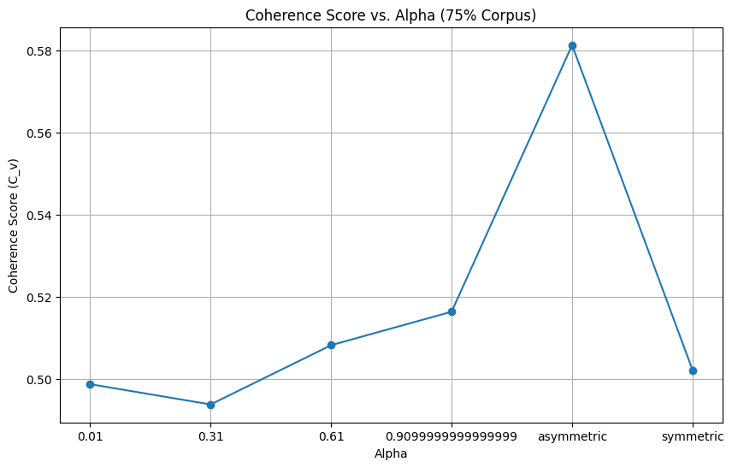
Hyperparameter tuning output
The graph visualizes the relationship between the alpha parameter and the coherence score (C_v) for a specific validation set (e.g., '75% Corpus’).
X-axis : Alpha
Y-axis : Coherence Score
The trend line helps visualize the relationship between alpha and coherence score.
By examining the graph, we can identify the optimal range or specific value of alpha that maximizes the coherence score. This information helps in selecting the most suitable alpha value for the LDA model, which in turn leads to better topic quality and interpretability.

Slide 27
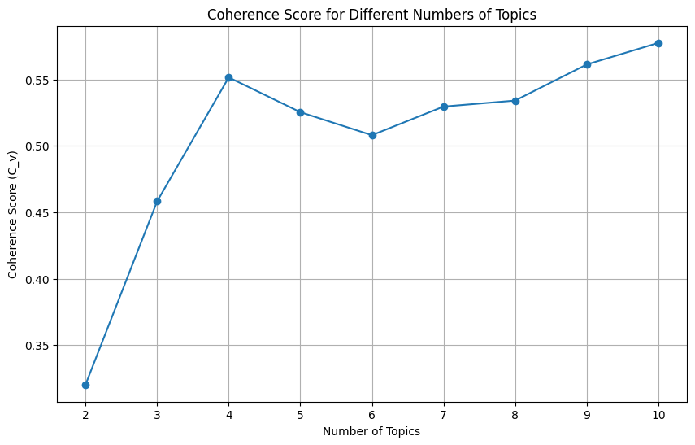
Visualizations of Topic Distributions
This graph visualizes the relationship between the number of topics and the coherence score (C_v) obtained from topic modeling using Latent Dirichlet Allocation (LDA).
X-axis (Number of Topics)
Y-axis (Coherence Score)
The trend line helps visualize how coherence scores vary with the number of topics.
By examining the graph, we can determine the impact of the number of topics on topic coherence. We aim to identify the point at which increasing the number of topics ceases to improve coherence significantly, indicating the optimal number of topics for our dataset.

